Slide 1
Software Debug and Control
Kevin Weldon
January 2022
Notes:
Two example designs created to show how to interface with Intel FPGAs (CSR) using software. Tcl and C

Slide 2
Goals
To demonstrate a platform which can be used to set control registers and read/respond to status (CSR) registers
Gain familiarity with Platform Designer as a tool to quickly design address mapped interfaces
Lean the basics of Intel’s Tcl API
Design simple Nios V design to demonstrate CSR access
Understand the Nios V tool flow
Obtain complete working example designs of both the Tcl and C flows

Slide 3
Tool Utilized in Example Designs
Platform Design
System integration tool used to automatically generate interconnect logic connect IP and subsystems
Nios V
Next generation soft processor based on the open-source RISC-V Instruction Set
JTAG to Avalon Bridge
IP core providing a connection between host systems (desktop computer) and an Avalon Interface based Platform Designer System
Avalon Interface
Defines a memory mapped and stream interface standard to communicate between IP blocks in Platform Designer

Slide 4
Documentation / Instructions
JTAG_Read_Write_Example_Guide_Tcl.doc
NiosV_Read_Write_Example_Guide_C.doc

Slide 5
Debug and Control Using TCL

Slide 6
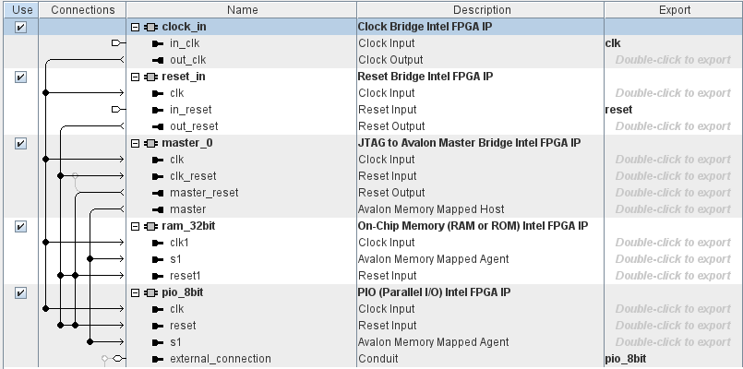
Platform Designer System – JTAG to Avalon Bridge

Slide 7
Platform Designer System – Block View
JTAG Connection from host PC
Avalon
Memory Mapped
Interface
clk
JTAG
master
clock_in
ram_32bit
reset
reset_in
pio_8bit
pio_8bit

Slide 8
Top Level System – Block View
JTAG Connection from host PC
Platform Designer
System
led
clk
issp_reset
reset

Slide 9
Reset Control Using Tcl
toggle_issp.tcl script is used to toggle the reset register
The script makes a connection to the FPGA through JTAG
The In System Sources and Probes (ISSP) register instantiated in the design is then toggled, providing a reset to the system
start_insystem_source_probe -hardware_name $hardware2use -device_name $device
write_source_data -instance_index $ISSP_INDEX -value "1"
after $RESET_MS
write_source_data -instance_index $ISSP_INDEX -value "0"
end_insystem_source_probe

Slide 10
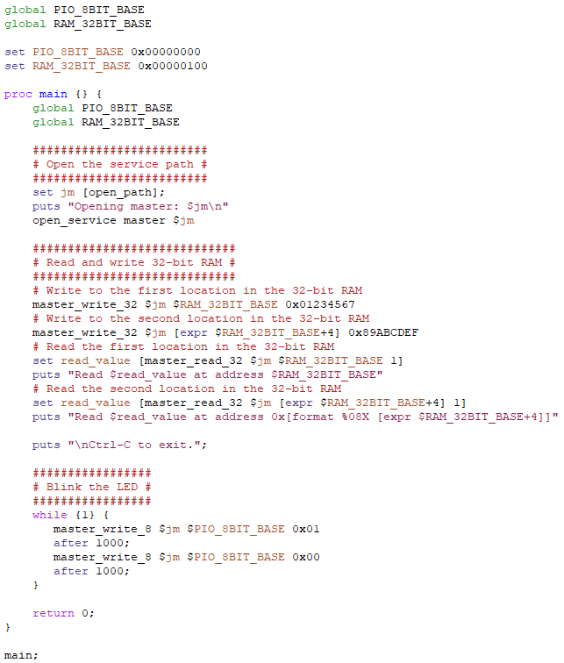
Debug & Control Tcl Script
The read_write_example.tcl script is used to interface with the FPGA.
Notes:
Global variables are used here to more closely match the structure of the equivalent C-code.

Slide 11
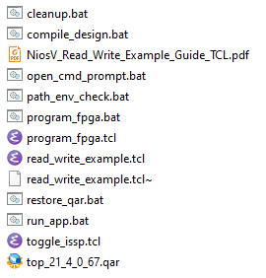
Example Project Contents
Filename | Description
cleanup.bat | Removes all restored and generated files.
compile_design.bat | Compiles the FPGA from a Windows Prompt.
NiosV_Read_Write_Example_Guilde.pdf | Description and instructions for the example design.
open_cmd_prompt.bat | Opens a Windows Command Prompt in the present working directory.
path_env_check.bat | Windows batch file to help check correctness of PATH environment variable.
program_fpga.bat | Windows batch file script to run the program_fpga.tcl and toggle_issp.tcl scripts from a Windows Prompt.
program_fpga.tcl | Tcl script to assist in the programming of the FPGA.
read_write_example.tcl | Software application file written in tcl.
restore_qar.bat | Windows batch file script to restore the Quartus project from the Quartus archive (.qar file)
run_app.bat | Windows batch file script to run the read_write_example.tcl application.
toggle_issp.tcl | Tcl script to toggle the internal reset register using In System Sources and Probes (ISSP).
top_21_4_0_67.qar | Quartus project archive file, including Platform Designer system and Verilog files.

Slide 12
Demo

Slide 13
Debug and Control Using C

Slide 14
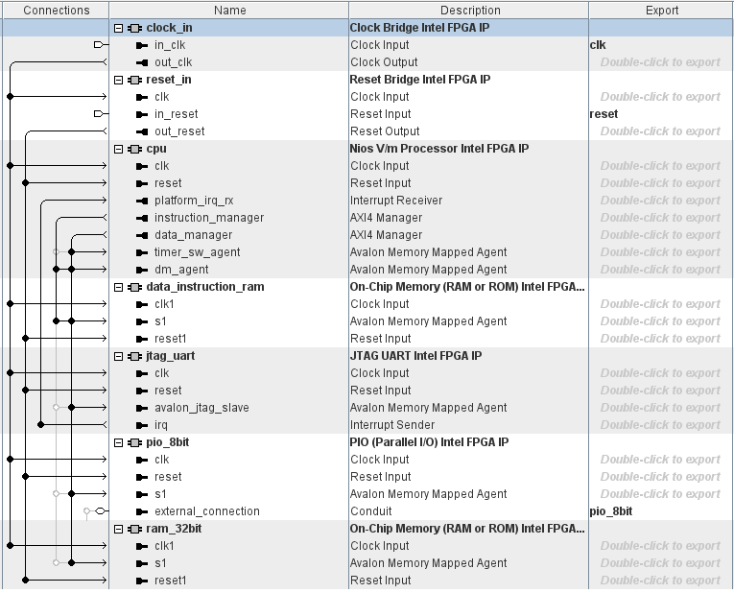
Platform Designer System – JTAG to Avalon Bridge

Slide 15
Platform Designer System – Block View
JTAG Connection from host PC
JTAG
UART
Data_instruction_ram
Avalon
Memory Mapped
Interface
clk
Nios V
ram_32bit
clock_in
reset
reset_in
pio_8bit
pio_8bit

Slide 16
Top Level System – Block View
JTAG Connection from host PC
Platform Designer
System
led
clk
issp_reset
reset

Slide 17
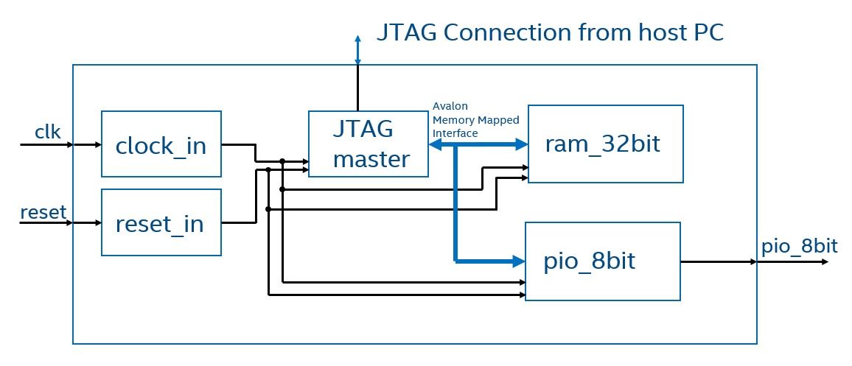
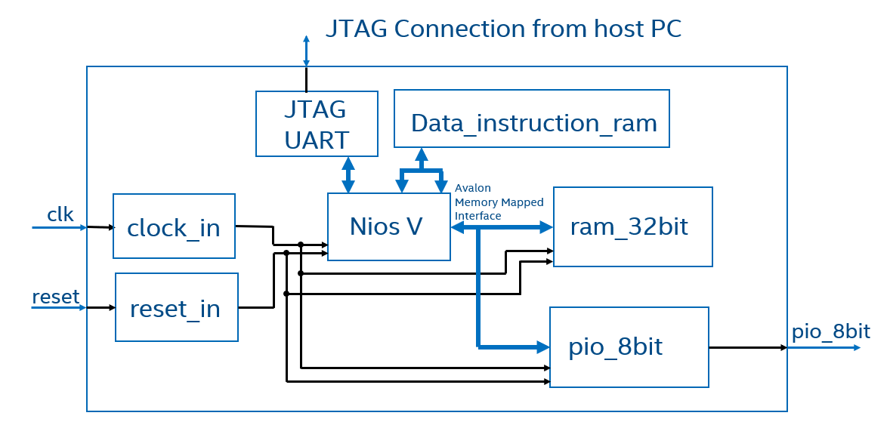
Block Diagram Comparison

Slide 18
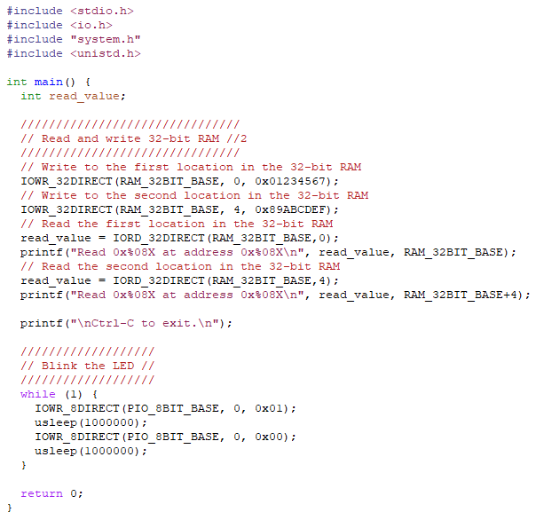
Debug & Control C Program
The read_write_example.c program is used to interface with the rest of the FPGA
IOWR_32DIRECT(RAM_32BIT_BASE, 0, 0x01234567);
The above command is similar to the following C instruction:
*(uint32_t*)(RAM_32BIT_BASE) = 0x01234567;
And is équivalent to the following Tcl API command:
master_write_32 $jm $RAM_32BIT_BASE 0x01234567

Slide 19
Code comparison

Slide 20
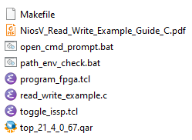
Example Project Contents
Filename | Description
Makefile | Makefile to build and manage FPGA and software application projects.
NiosV_Read_Write_Example_Guilde.pdf | This document.
open_cmd_prompt.bat | Opens a Windows Command Prompt in the present working directory.
path_env_check.bat | Window batch file to help check correctness of PATH environment variable.
program_fpga.tcl | Tcl script to assist in the programming of the FPGA.
read_write_example.c | Software application file written in C.
toggle_issp.tcl | Tcl script to toggle the internal reset register using In System Sources and Probes (ISSP).
top_21_4_0_67.qar | Quartus project archive file. Including Platform Designer system and top-level System Verilog file.

Slide 21
Software Required for Nios V
GNU RISC-V Embedded GCC
https://github.com/xpack-dev-tools/riscv-none-embed-gcc-xpack/releases/tag/v8.3.0-2.3
Download file: xpack-riscv-none-embed-gcc-8.3.0-2.3-win32-x64.zip
Extract file in Quartus install directory
C:\intelFPGA_pro\21.4\niosv
CMake packages for binary distributes
https://cmake.org/download/
Download file: cmake-3.21.4-windows-x86_64.zip
Extract file in Quartus install directory
C:\intelFPGA_pro\21.4\niosv
xPack Windows Build Tools
https://github.com/xpack-dev-tools/windows-build-tools-xpack/releases/
Download file: xpack-windows-build-tools-4.2.1-2-win32-x64.zip
Extract file in Quartus install directory
C:\intelFPGA_pro\21.4\niosv

Slide 22
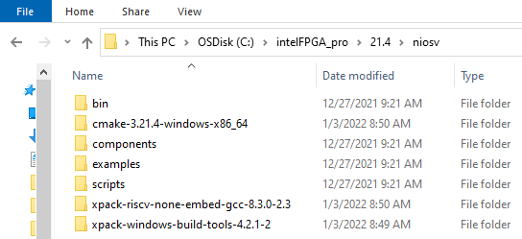
Software Required for Nios V

Slide 23
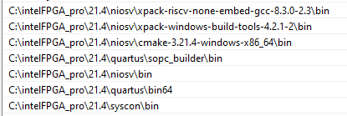
Path Environment Variable for Nios V

Slide 24
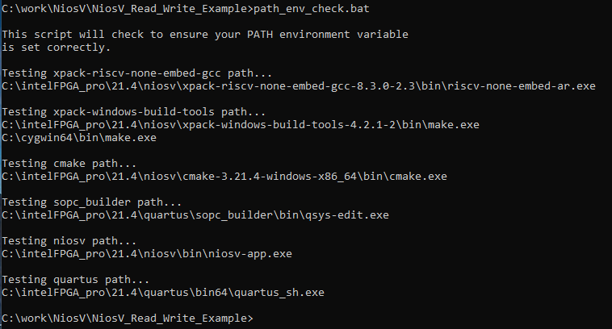
Verify Path Correctness

Slide 25
Demo

